Slide 1
Hi-fi Prototype
CZ2004 Assignment 3
Huang Jingfang (DSAI 3)

Slide 2
Content
Home Page
Part I : Explore the Park
Part II : Plan the Trips
Part III : View the Trips

Slide 3
Part (I) Features
Main interface
Show locations according to categories
Information display
Sort the locations based on different criteria
Create a route and add selected locations to the route
Undo
Collapse the side bar
Messages from AI assistant

Slide 4
Part (II) Features
Display current plans
Rename the route
Edit the route (drag and drop to change sequences, remove locations)
Dynamically update the route shown on the map and the distance between different locations
Create a new route (allow splitting of groups)
Generate a recommended route based on user’s emotion
Extend the side bar to view Summary panel
Book rides/live shows
Make reservations for restaurants
Messages from AI assistant

Slide 5
Part (III) Features
Display visited locations
Display estimated time to complete the trip
Expand the side bar to display the overall schedule
Make changes to the current plans
Messages from AI assistant

Slide 6
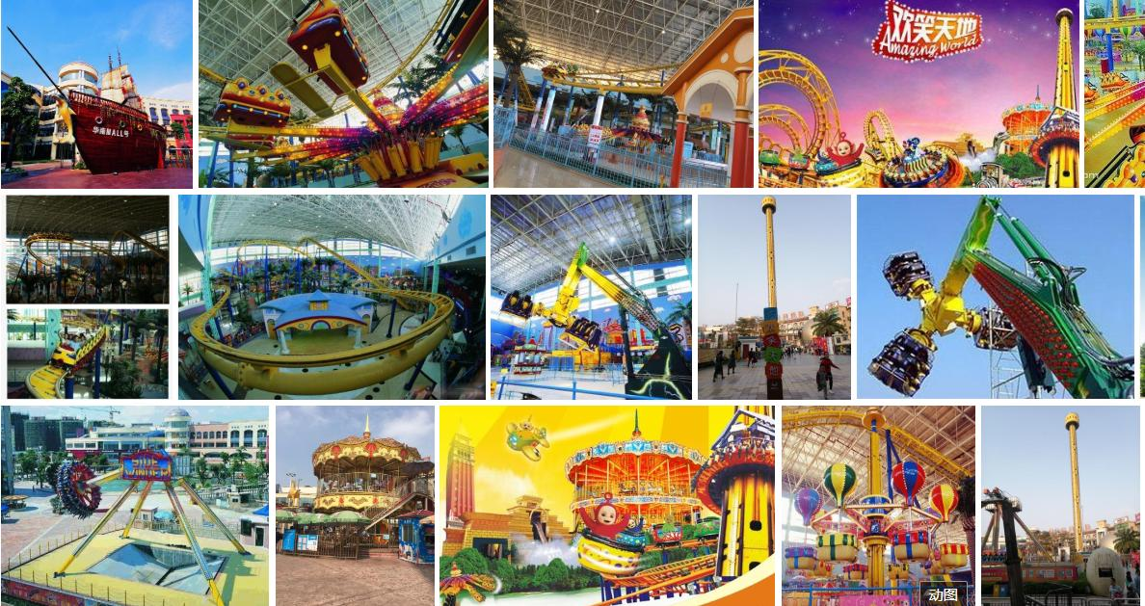




Home Page
Scan your QR code or key in user ID to enter
Log out
View trips
Contact Us
Language
Notes:
This Photo by Unknown Author is licensed under CC BY-SA

Slide 7
Home Page
Hi , Julia !
Log out
View trips
Contact Us
Language
Notes:
This Photo by Unknown Author is licensed under CC BY-SA

Slide 8

Language Setting
English
中文
Scan your QR code or key in user ID to enter
日本語
한국어
Bahasa Melayu
தமிழ்
Log out
View trips
Contact Us
Language
Notes:
This Photo by Unknown Author is licensed under CC BY-SA

Slide 9
Home Page
Hi , Julia !
Log out
View trips
Contact Us
Language
Notes:
This Photo by Unknown Author is licensed under CC BY-SA

Slide 10


Contact Us
Feedback
Scan your QR code or key in user ID to enter
Call for Assistance
Log out
View trips
Contact Us
Language
Notes:
This Photo by Unknown Author is licensed under CC BY-SA

Slide 11
Contact Us
Feedback
Tap here to type
Scan your QR code or key in user ID to enter
Submit
Log out
View trips
Contact Us
Language
Notes:
This Photo by Unknown Author is licensed under CC BY-SA

Slide 12
Contact Us
Feedback
Scan your QR code or key in user ID to enter
Call for Assistance
Log out
View trips
Contact Us
Language
Notes:
This Photo by Unknown Author is licensed under CC BY-SA

Slide 13


Call
Feedback
Call for Assistance
Scan your QR code or key in user ID to enter
Hi, our staff Mary is assisting you!
00:28
Log out
View trips
Contact Us
Language
Notes:
This Photo by Unknown Author is licensed under CC BY-SA

Slide 14
Home Page
Hi , Julia !
Log out
View trips
Contact Us
Language
Notes:
This Photo by Unknown Author is licensed under CC BY-SA

Slide 15









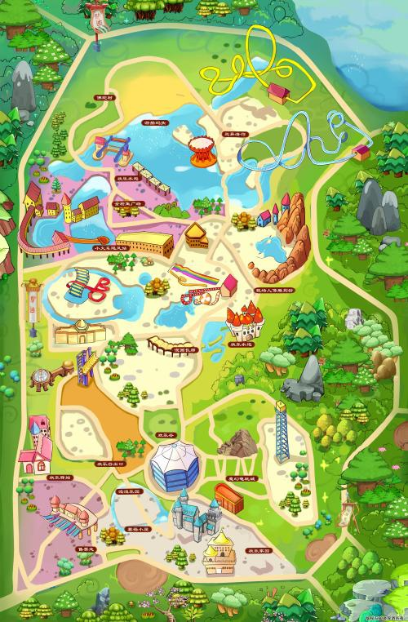




Main Interface
20/05/2022
10 : 30
Explore the Park
Plan the Trips
View the Trips
Hi, Julia
Category:
Where would you like to visit?
Price
ALL
Rides
F & B
Shows
Rating
Walking Distance
Waiting Time
Welcome to Multiversal Studios !
: Your current Location

Slide 16

Highlight the locations under the same category
20/05/2022
10 : 30
Explore the Park
Plan the Trips
View the Trips
Hi, Julia
Category:
Rides
Where would you like to visit?
Price
ALL
Rides
F & B
Shows
Rating
Walking Distance
Waiting Time
Tap the icon to view the information of the locations !
: Your current Location

Slide 17
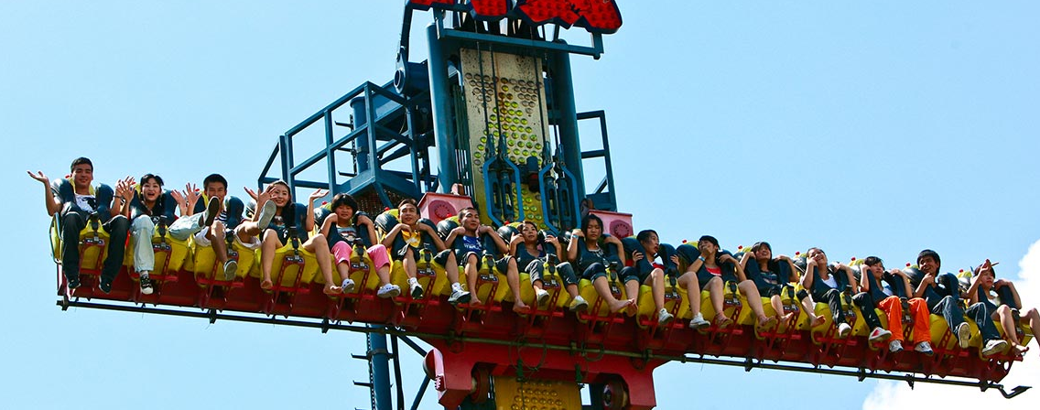


Display Information of the location
20/05/2022
10 : 30
Explore the Park
Plan the Trips
View the Trips
Hi, Julia
Category:
Rides
Where would you like to visit?
Price
ALL
Rides
F & B
Shows
Rating
Walking Distance
Waiting Time
Drop Tower
Introduction: XXXXXXXXXXX
Age requirement: 13 Yrs Old
Price: $30 / Pax
Reviews: XXXXXX
Tap the icon to view the information of the locations !
: Your current Location

Slide 18
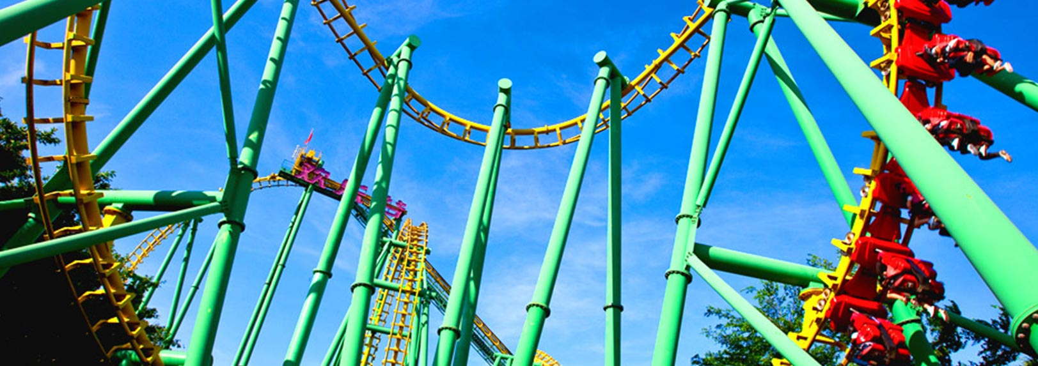
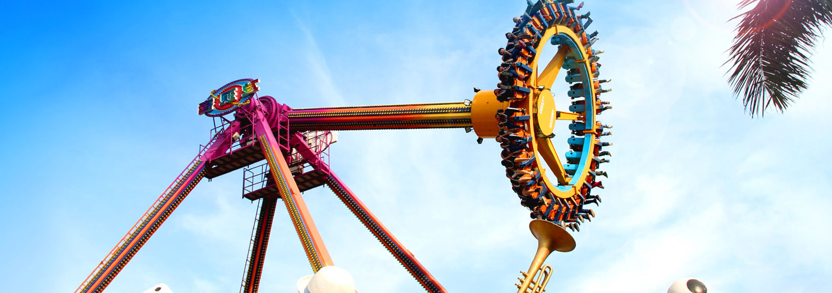

Sort Locations based on Rating
20/05/2022
10 : 30
Explore the Park
Plan the Trips
View the Trips
Hi, Julia
Category:
Rides
Where would you like to visit?
Price
ALL
Rides
F & B
Shows
Rating
Roller Coaster
Drop Tower
Rating:
Introduction: XXXXXXXXXXX
Age requirement: 13 Yrs Old
Price: $30 / Pax
Comments: XXXXXX
UltraMax
Tap the icon to view the information of the locations !
Rating:
Drop Tower
Rating:
Top Spin
Rating:
Walking Distance
: Your current Location
Waiting Time

Slide 19
Create a Route
20/05/2022
10 : 30
Explore the Park
Plan the Trips
View the Trips
Hi, Julia
Category:
Rides
Where would you like to visit?
Price
ALL
Rides
F & B
Shows
Rating
Create new route
Roller Coaster
Cancel
Drop Tower
Rating:
Introduction: XXXXXXXXXXX
Age requirement: 13 Yrs Old
Price: $30 / Pax
Comments: XXXXXX
UltraMax
Rating:
Drop Tower
Rating:
Top Spin
Rating:
Walking Distance
: Your current Location
Waiting Time

Slide 20
Name the Route
20/05/2022
10 : 30
Explore the Park
Plan the Trips
View the Trips
Hi, Julia
Category:
Rides
Where would you like to visit?
Price
ALL
Rides
F & B
Shows
Rating
Create new route
Roller Coaster
Cancel
Drop Tower
Please name your new route:
Tap here to type
Rating:
Introduction: XXXXXXXXXXX
Age requirement: 13 Yrs Old
Price: $30 / Pax
Comments: XXXXXX
UltraMax
Confirm
Cancel
Rating:
Drop Tower
Rating:
Top Spin
Rating:
Walking Distance
Waiting Time

Slide 21
Name the Route
20/05/2022
10 : 30
Explore the Park
Plan the Trips
View the Trips
Hi, Julia
Category:
Rides
Where would you like to visit?
Price
ALL
Rides
F & B
Shows
Rating
Create new route
Roller Coaster
Cancel
Drop Tower
Please name your new route:
My Route
Rating:
Introduction: XXXXXXXXXXX
Age requirement: 13 Yrs Old
Price: $30 / Pax
Comments: XXXXXX
UltraMax
Confirm
Cancel
Rating:
Drop Tower
Rating:
Top Spin
Rating:
Walking Distance
Waiting Time

Slide 22

Add selected location to the Route
20/05/2022
10 : 30
Explore the Park
Plan the Trips
View the Trips
Hi, Julia
Category:
Rides
Where would you like to visit?
Price
ALL
Rides
F & B
Shows
My Route
Rating
Create new route
Roller Coaster
Cancel
Drop Tower
Rating:
Introduction: XXXXXXXXXXX
Age requirement: 13 Yrs Old
Price: $30 / Pax
Comments: XXXXXX
UltraMax
You can check all the locations you’ve added in [Plan the trips] page! ~~
Rating:
Drop Tower
Rating:
Top Spin
Rating:
Walking Distance
: Your current Location
Waiting Time

Slide 23
Undo
20/05/2022
10 : 30
Explore the Park
Plan the Trips
View the Trips
Hi, Julia
Category:
Rides
Where would you like to visit?
Price
ALL
Rides
F & B
Shows
Rating
Create new route
Roller Coaster
Cancel
Drop Tower
Rating:
Introduction: XXXXXXXXXXX
Age requirement: 13 Yrs Old
Price: $30 / Pax
Comments: XXXXXX
UltraMax
Rating:
Drop Tower
Rating:
Top Spin
Rating:
Walking Distance
: Your current Location
Waiting Time

Slide 24
Collapse the Side Bar
20/05/2022
10 : 30
Explore the Park
Plan the Trips
View the Trips
Hi, Julia
Where would you like to visit?
ALL
Rides
F & B
Shows
Welcome to Multiversal Studios !
: Your current Location

Slide 25



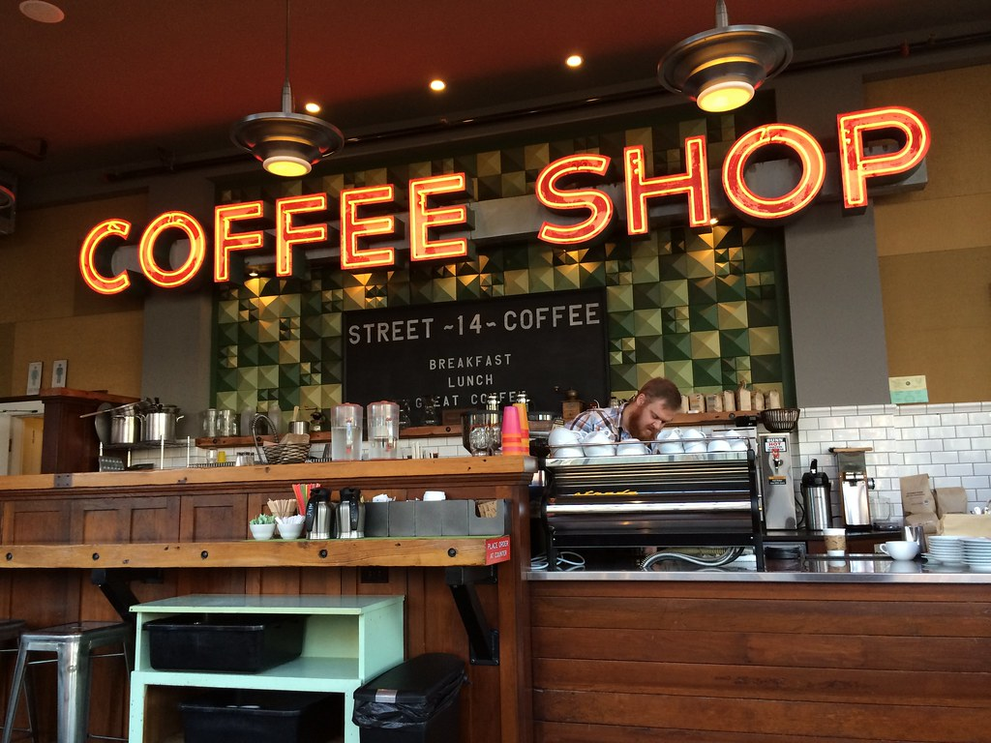
Display the Current plan
20/05/2022
10 : 30
Explore the Park
Plan the Trips
View the Trips
Hi, Julia
My Route
Recommended Route
Where would you like to visit?
Roller Coaster
Book
My Route
300m
Price: $30 / Pax
Estimated Waiting time: 30 min
UltraMax
Book
500m
300m
Price: $35 / Pax
Estimated Waiting time: 20 min
Hi! This is your current plan. Your edited plan will automatically be updated on the map :D
Coffee Shop
Reserve
Average Price: $12 / Pax
Estimated Waiting time: 0 min
Pizza Hut
Reserve
: Your current Location
Add a new route

Slide 26
Rename the Route
20/05/2022
10 : 30
Explore the Park
Plan the Trips
View the Trips
Hi, Julia
My Route
Recommended Route
Where would you like to visit?
Roller Coaster
Book
My Route
300m
Price: $30 / Pax
Estimated Waiting time: 30 min
UltraMax
Book
500m
300m
Price: $35 / Pax
Estimated Waiting time: 20 min
Tap the Rename icon beside the name of your route to rename!
Coffee Shop
Reserve
Average Price: $12 / Pax
Estimated Waiting time: 0 min
Pizza Hut
Reserve
: Your current Location
Add a new route

Slide 27
Rename the Route
20/05/2022
10 : 30
Explore the Park
Plan the Trips
View the Trips
Hi, Julia
My Route
Recommended Route
Where would you like to visit?
Roller Coaster
Book
My Route
Price: $30 / Pax
Estimated Waiting time: 30 min
Please name your new route:
UltraMax
Book
Julia’s Route
Confirm
Cancel
Price: $35 / Pax
Estimated Waiting time: 20 min
Tap the Rename icon beside the name of your route to rename!
Coffee Shop
Reserve
Average Price: $12 / Pax
Estimated Waiting time: 0 min
Pizza Hut
Reserve
: Your current Location
Add a new route

Slide 28
Edit the Route
20/05/2022
10 : 30
Explore the Park
Plan the Trips
View the Trips
Hi, Julia
Julia’s Route
Recommended Route
Where would you like to visit?
Roller Coaster
Book
Julia’s Route
300m
Price: $30 / Pax
Estimated Waiting time: 30 min
UltraMax
Book
500m
300m
Price: $35 / Pax
Estimated Waiting time: 20 min
Drag and drop to change the sequence !
Coffee Shop
Reserve
Average Price: $12 / Pax
Estimated Waiting time: 0 min
Pizza Hut
Reserve
: Your current Location
Add a new route

Slide 29
Edit the Route
20/05/2022
10 : 30
Explore the Park
Plan the Trips
View the Trips
Hi, Julia
Julia’s Route
Recommended Route
Where would you like to visit?
UltraMax
Book
Julia’s Route
300m
Price: $35 / Pax
Estimated Waiting time: 20 min
Roller Coaster
Book
450m
300m
Price: $30 / Pax
Estimated Waiting time: 30 min
Drag and drop to change the sequence !
Coffee Shop
Reserve
Average Price: $12 / Pax
Estimated Waiting time: 0 min
Pizza Hut
Reserve
: Your current Location
Add a new route

Slide 30
Edit the Route
20/05/2022
10 : 30
Explore the Park
Plan the Trips
View the Trips
Hi, Julia
Julia’s Route
Recommended Route
Where would you like to visit?
UltraMax
Book
Julia’s Route
300m
Price: $35 / Pax
Estimated Waiting time: 20 min
Roller Coaster
Book
450m
300m
Price: $30 / Pax
Estimated Waiting time: 30 min
You may remove the locations that you do not wish to visit!
Coffee Shop
Reserve
Average Price: $12 / Pax
Estimated Waiting time: 0 min
Pizza Hut
Reserve
: Your current Location
Add a new route

Slide 31
Edit the Route
20/05/2022
10 : 30
Explore the Park
Plan the Trips
View the Trips
Hi, Julia
Julia’s Route
Recommended Route
Where would you like to visit?
UltraMax
Book
Julia’s Route
Price: $35 / Pax
Estimated Waiting time: 20 min
Do you wish to remove this location?
Pizza Hut
Roller Coaster
Book
Confirm
Cancel
Price: $30 / Pax
Estimated Waiting time: 30 min
You may remove the locations that you do not wish to visit!
Coffee Shop
Reserve
Average Price: $12 / Pax
Estimated Waiting time: 0 min
Pizza Hut
Reserve
: Your current Location
Add a new route

Slide 32
Edit the Route
20/05/2022
10 : 30
Explore the Park
Plan the Trips
View the Trips
Hi, Julia
Julia’s Route
Recommended Route
Where would you like to visit?
UltraMax
Book
Julia’s Route
300m
Price: $35 / Pax
Estimated Waiting time: 20 min
Roller Coaster
Book
450m
Price: $30 / Pax
Estimated Waiting time: 30 min
Location Pizza Hut has been successfully removed !
Coffee Shop
Reserve
Average Price: $12 / Pax
Estimated Waiting time: 0 min
: Your current Location
Add a new route

Slide 33
Create another route (for multiple users)
20/05/2022
10 : 30
Explore the Park
Plan the Trips
View the Trips
Hi, Julia
Julia’s Route
Recommended Route
Where would you like to visit?
UltraMax
Book
Julia’s Route
300m
Price: $35 / Pax
Estimated Waiting time: 20 min
Roller Coaster
Book
450m
Price: $30 / Pax
Estimated Waiting time: 30 min
Feel free to create a new route for your friends/ family! Just tap the bottom right icon !
Coffee Shop
Reserve
Average Price: $12 / Pax
Estimated Waiting time: 0 min
: Your current Location
Add a new route

Slide 34
Create another route (for multiple users)
20/05/2022
10 : 30
Explore the Park
Plan the Trips
View the Trips
Hi, Julia
Julia’s Route
Recommended Route
Where would you like to visit?
UltraMax
Book
Julia’s Route
Price: $35 / Pax
Estimated Waiting time: 20 min
Please name the new route:
Dad & Mom
Roller Coaster
Book
Confirm
Cancel
Price: $30 / Pax
Estimated Waiting time: 30 min
Feel free to create a new route for your friends/ family! Just tap the bottom right icon !
Coffee Shop
Reserve
Average Price: $12 / Pax
Estimated Waiting time: 0 min
: Your current Location
Add a new route

Slide 35
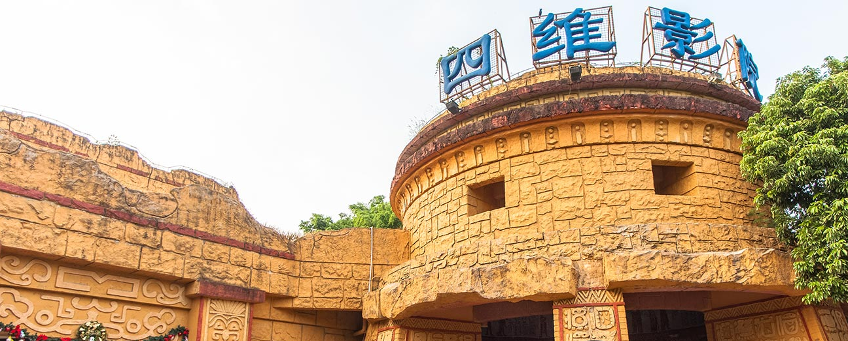
Create another route (for multiple users)
20/05/2022
10 : 30
Explore the Park
Plan the Trips
View the Trips
Hi, Julia
Julia’s Route
Recommended Route
Where would you like to visit?
Dad & Mom
Julia’s Route
Dad & Mom
4D Cinema
Book
Price: $25 / Pax
Estimated Waiting time: 10 min
Tap the locations on the map and add them to the new route you’ve created !
: Your current Location
Add a new route

Slide 36
Duplicate Route
20/05/2022
10 : 30
Explore the Park
Plan the Trips
View the Trips
Hi, Julia
Julia’s Route
Recommended Route
Where would you like to visit?
Dad & Mom
Julia’s Route
Dad & Mom
4D Cinema
Book
Price: $25 / Pax
Estimated Waiting time: 10 min
Tap the locations on the map and add them to the new route you’ve created !
: Your current Location
Add a new route

Slide 37
Duplicate Route
20/05/2022
10 : 30
Explore the Park
Plan the Trips
View the Trips
Hi, Julia
Julia’s Route
Recommended Route
Where would you like to visit?
Dad & Mom
Julia’s Route
Dad & Mom
4D Cinema
Delete the route
Book
Duplicate the route
Cancel
Price: $25 / Pax
Estimated Waiting time: 10 min
Tap the locations on the map and add them to the new route you’ve created !
: Your current Location
Add a new route

Slide 38
Duplicate Route
20/05/2022
10 : 30
Explore the Park
Plan the Trips
View the Trips
Hi, Julia
Julia’s Route
Recommended Route
Where would you like to visit?
Dad & Mom
Julia’s Route
Dad & Mom
Dad & Mom (2)
4D Cinema
Book
Price: $25 / Pax
Estimated Waiting time: 10 min
Dad & Mom (2)
Tap the locations on the map and add them to the new route you’ve created !
: Your current Location
Add a new route

Slide 39
Delete Route
20/05/2022
10 : 30
Explore the Park
Plan the Trips
View the Trips
Hi, Julia
Julia’s Route
Recommended Route
Where would you like to visit?
Dad & Mom
Julia’s Route
Dad & Mom
4D Cinema
Delete the route
Book
Duplicate the route
Cancel
Price: $25 / Pax
Estimated Waiting time: 10 min
Tap the locations on the map and add them to the new route you’ve created !
: Your current Location
Add a new route

Slide 40
Delete Route
20/05/2022
10 : 30
Explore the Park
Plan the Trips
View the Trips
Hi, Julia
Julia’s Route
Recommended Route
Where would you like to visit?
Dad & Mom
Julia’s Route
Dad & Mom
4D Cinema
Book
Do you wish to delete this route?
Price: $25 / Pax
Estimated Waiting time: 10 min
Dad & Mom
Confirm
Cancel
Tap the locations on the map and add them to the new route you’ve created !
: Your current Location
Add a new route

Slide 41


Delete Route
20/05/2022
10 : 30
Explore the Park
Plan the Trips
View the Trips
Hi, Julia
Julia’s Route
Recommended Route
Where would you like to visit?
Dad & Mom
Julia’s Route
Dad & Mom
4D Cinema
Book
Route deleted
Price: $25 / Pax
Estimated Waiting time: 10 min
Undo
Tap the locations on the map and add them to the new route you’ve created !
: Your current Location
Add a new route

Slide 42
Generate a Recommended Route (Based on user’s emotion)
20/05/2022
10 : 30
Explore the Park
Plan the Trips
View the Trips
Hi, Julia
Julia’s Route
Recommended Route
Where would you like to visit?
Dad & Mom
Julia’s Route
Dad & Mom
Recommended Route
Roller Coaster
Book
250m
Price: $30 / Pax
Estimated Waiting time: 30 min
4D Cinema
Book
300m
200m
Lack of ideas? Generate a [Recommended Route] !
Price: $25 / Pax
Estimated Waiting time: 10 min
Burger King
Reserve
Estimated Waiting time: 5 min
Gift Shop
Estimated Waiting time: 0 min
: Your current Location
Add a new route

Slide 43
View the Summary of the Route
20/05/2022
10 : 30
Explore the Park
Plan the Trips
View the Trips
Hi, Julia
Julia’s Route
Recommended Route
Where would you like to visit?
UltraMax
Book
Julia’s Route
Dad & Mom
300m
Price: $35 / Pax
Estimated Waiting time: 20 min
Roller Coaster
Book
450m
300m
Price: $30 / Pax
Estimated Waiting time: 30 min
Extend the side bar to view the Summary of the route
Coffee Shop
Reserve
Average Price: $12 / Pax
Estimated Waiting time: 0 min
Dad & Mom
: Your current Location
Add a new route

Slide 44
View the Summary of the Route
20/05/2022
10 : 30
Explore the Park
Plan the Trips
View the Trips
Hi, Julia
Summary
Julia’s Route
Recommended Route
Total Estimated Walking Distance:
UltraMax
Book
Julia’s Route
Dad & Mom
1050 m
300m
Total Time Estimated to Complete the Route:
Price: $35 / Pax
Estimated Waiting time: 20 min
Tap [BOOK ALL] to book all the selected locations at one go!
Roller Coaster
3 h 40 min
Book
450m
Total Cost Estimated (Excluding food):
300m
S$ 88
Price: $30 / Pax
Estimated Waiting time: 30 min
Coffee Shop
Reserve
Average Price: $12 / Pax
Estimated Waiting time: 0 min
Dad & Mom
: Your current Location
BOOK ALL
Add a new route

Slide 45
Book Rides/Live show
20/05/2022
10 : 30
Explore the Park
Plan the Trips
View the Trips
Hi, Julia
Julia’s Route
Recommended Route
Where would you like to visit?
UltraMax
Book
Julia’s Route
Dad & Mom
300m
Price: $35 / Pax
Estimated Waiting time: 20 min
Roller Coaster
Book
450m
300m
Price: $30 / Pax
Estimated Waiting time: 30 min
Let’s book the ride to reduce waiting time !
Coffee Shop
Reserve
Average Price: $12 / Pax
Estimated Waiting time: 0 min
Dad & Mom
: Your current Location
Add a new route

Slide 46
Book Rides/Live show
20/05/2022
10 : 30
Explore the Park
Plan the Trips
View the Trips
Hi, Julia
Julia’s Route
Recommended Route
Where would you like to visit?
UltraMax
Book
Julia’s Route
Dad & Mom
Please choose your preferred time slot:
09:00 – 09:30
10:00 – 10:30
11:00 – 11:30
13:00 – 13:30
14:00 – 14:30
15:00 – 15:30
Price: $35 / Pax
Estimated Waiting time: 20 min
Roller Coaster
Book
Price: $30 / Pax
Estimated Waiting time: 30 min
Let’s book the ride to reduce waiting time !
Coffee Shop
Reserve
Confirm
Cancel
Average Price: $12 / Pax
Estimated Waiting time: 0 min
Dad & Mom
: Your current Location
Add a new route

Slide 47
Make Reservations
20/05/2022
15 : 30
Explore the Park
Plan the Trips
View the Trips
Hi, Julia
Julia’s Route
Recommended Route
Where would you like to visit?
UltraMax
Book
Julia’s Route
Dad & Mom
300m
Price: $35 / Pax
Estimated Waiting time: 20 min
Roller Coaster
Book
450m
300m
Price: $30 / Pax
Estimated Waiting time: 30 min
Tap [Reserve] to make the reservation at Coffee Shop
Coffee Shop
Reserve
Average Price: $12 / Pax
Estimated Waiting time: 0 min
Dad & Mom
: Your current Location
Add a new route

Slide 48
Make Reservations
20/05/2022
10 : 30
Explore the Park
Plan the Trips
View the Trips
Hi, Julia
Julia’s Route
Recommended Route
Where would you like to visit?
UltraMax
Book
Julia’s Route
Dad & Mom
Please choose your preferred time slot:
09:00 – 10:00
10:00 – 11:00
11:00 – 12:00
13:00 – 14:00
14:00 – 15:00
Price: $35 / Pax
Estimated Waiting time: 20 min
Roller Coaster
Book
Price: $30 / Pax
Estimated Waiting time: 30 min
Choose number of pax:
1
Coffee Shop
Reserve
Let’s book the ride to reduce waiting time !
Confirm
Cancel
Average Price: $12 / Pax
Estimated Waiting time: 0 min
Dad & Mom
: Your current Location
Add a new route

Slide 49


View Visited Locations
20/05/2022
10 : 30
Explore the Park
Plan the Trips
View the Trips
Hi, Julia
Julia’s Route
En-Route
Where would you like to visit?
UltraMax
Book
Julia’s Route
Dad & Mom
Price: $35 / Pax
Estimated Waiting time: 20 min
Roller Coaster
Book
450m
300m
Price: $30 / Pax
Estimated Waiting time: 30 min
You may still make changes to your plan, or view your friends’ visited locations!
Coffee Shop
Reserve
Average Price: $12 / Pax
Estimated Waiting time: 0 min
Dad & Mom
: Your current Location
Add a new route

Slide 50
Alternatively, you can also the [View the Trips] page from Home page if you are a returning visitor at another kiosk ~
Home Page
Hi , Julia !
Log out
View trips
Contact Us
Language
Notes:
This Photo by Unknown Author is licensed under CC BY-SA

Slide 51
View the Schedule
20/05/2022
10 : 30
Explore the Park
Plan the Trips
View the Trips
Hi, Julia
Julia’s Route
En-Route
Where would you like to visit?
UltraMax
Book
Julia’s Route
Dad & Mom
Price: $35 / Pax
Estimated Waiting time: 20 min
Roller Coaster
Book
450m
300m
Price: $30 / Pax
Estimated Waiting time: 30 min
View your schedule by extend the side bar
Coffee Shop
Reserve
Average Price: $12 / Pax
Estimated Waiting time: 0 min
Dad & Mom
: Your current Location
Add a new route

Slide 52
View the Schedule
20/05/2022
10 : 30
Explore the Park
Plan the Trips
View the Trips
Hi, Julia
Planned
Schedule
Julia’s Route
Actual
Where would you like to visit?
UltraMax
Book
Julia’s Route
Dad & Mom
11:00
11:30
11:00
11:30
Delayed: 0 min
Price: $35 / Pax
Estimated Waiting time: 20 min
Roller Coaster
Book
12:00
12:30
13:00
13:30
Delayed: 60 min
Price: $30 / Pax
Estimated Waiting time: 30 min
View your schedule by extend the side bar
Coffee Shop
Reserve
15:00
16:00
15:20
16:10
Delayed: 20 min
Average Price: $12 / Pax
Estimated Waiting time: 0 min
Dad & Mom
Have a nice day ! :D
: Your current Location
Add a new route

Slide 53
To Log out
20/05/2022
10 : 30
Explore the Park
Plan the Trips
View the Trips
Hi, Julia
Julia’s Route
En-Route
Where would you like to visit?
UltraMax
Book
Julia’s Route
Dad & Mom
Price: $35 / Pax
Estimated Waiting time: 20 min
Roller Coaster
Book
450m
300m
Price: $30 / Pax
Estimated Waiting time: 30 min
View your schedule by extend the side bar
Coffee Shop
Reserve
Average Price: $12 / Pax
Estimated Waiting time: 0 min
Dad & Mom
: Your current Location
Add a new route

Slide 54
Home Page
Hi , Julia !
Log out
View trips
Contact Us
Language
Notes:
This Photo by Unknown Author is licensed under CC BY-SA

Slide 55
Home Page
Hi , Julia !
Do you wish to log out?
Confirm
Cancel
Log out
View trips
Contact Us
Language
Notes:
This Photo by Unknown Author is licensed under CC BY-SA

Slide 56
Thank you !

Slide 57
Reference
All the photos and maps used in this slides are from Shenzhen Happy Valley official website:
http://sz.happyvalley.cn/frmindex.aspx
All the icons are from Microsoft PPT.

